Slide 1



A COMPREHENSIVE ANALYSIS OF ZARA'S SUPPLY CHAIN
Course. Class. Lecturer.
Intro to Supply EC214.M11 Mrs. Nguyễn
Chain Management Minh Hằng

Slide 2




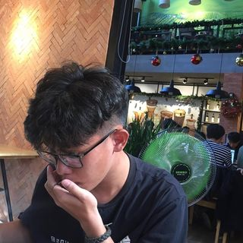





MEMBER LIST
Group 11
NGUYỄN THỊ THU THẢO
18521421
Girl leader with a charming & captivating beauty
ĐỖ THỊ NHƯ QUỲNH
18521421
Girl member no. 1 – origin of the spiritual matters in the group
HUỲNH LONG THÀNH ĐẠT
18520567
Boy member no. 1 – the worst luck in the group
PHAN THANH HẢI
18520705
Boy member no. 2 – rapper swearing like listening to rap
NGUYỄN THỊ THÚY QUỲNH
18521327
Girl member no. 2 – the most modest saint in the group

Slide 3
TABLE OF CONTENTS
1
INTRODUCTION
2
CURRENT STATE ASSESSMENT
3
SUPPLY CHAIN ANALYSIS
4
INTEGRATING ERP INTO SUPPLY CHAIN MANAGEMENT
5
CONCLUSION

Slide 4



INTRODUCTION
WHY?
Was it destiny that guided us?
OVERVIEW
Zara's Information & Overview

Slide 5

WHY?
ZARA's Success, What Is It Attributed To?
SUPPLY CHAIN
Fashion – Essential Demand.
Now, EAT WELL, DRESS WELL.
Preferred by women.
Well-known fashion brands:
Hermes, Chanel, Louis, H&M…
ZARA - the largest
fashion retailer in the world

Slide 6
SALES OF MAJOR APPAREL MANUFACTURERS AND RETAILERS WORLDWIDE IN THE FISCAL YEAR 2019
Fast Retailing – Major Global Apparel Manufacturer and Retailer (Billions of dollar)
INDITEX (ZARA)
28,89$
FAST RETAILING (UNIQLO)
21,51$
Hennes & Mauritz
21,5$
Gap
16,58$
Limited Brands
13,24$

Slide 7

1975
Amancio Ortega opened the first Zara store in Spain
HISTORY & MILESTONES OF
1984
The first logistics center in Arteixo is opened
1985
Inditex (parent) made it official
1988
Zara began expanding its market internationally
2003
Founded Zara Home
2010
Moved into online commerce

Slide 8
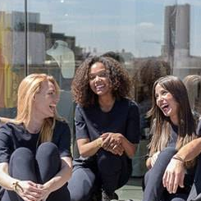

VISION
To contribute to the sustainable development of society and that of the environment with which we interact
MISSION
To give customers what
they want, and get it to them
faster than anyone else

Slide 9
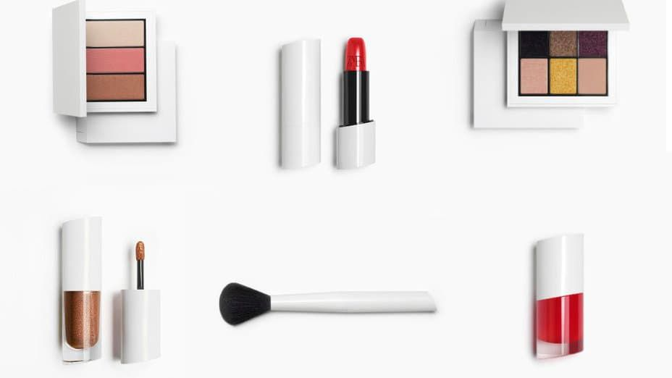
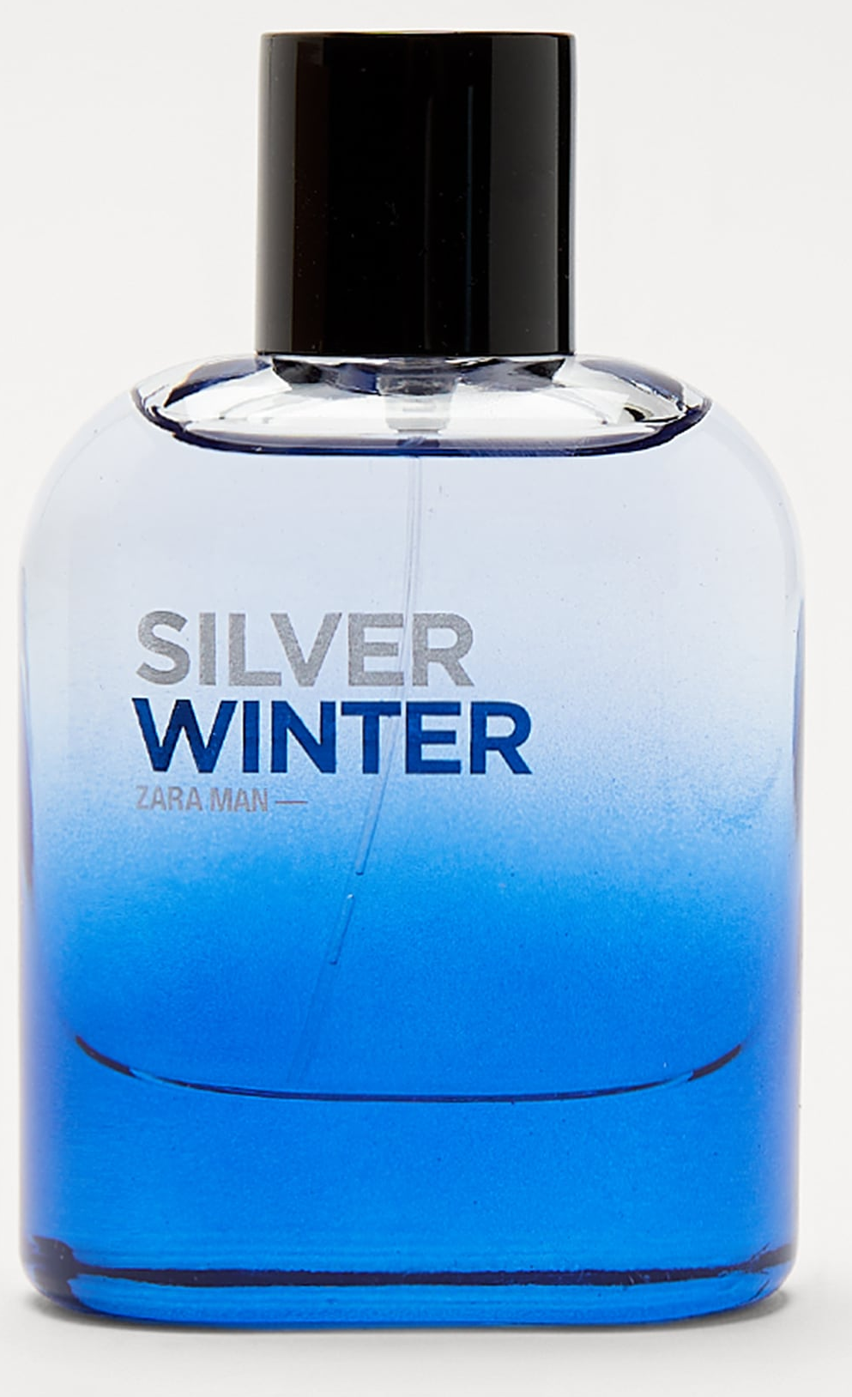
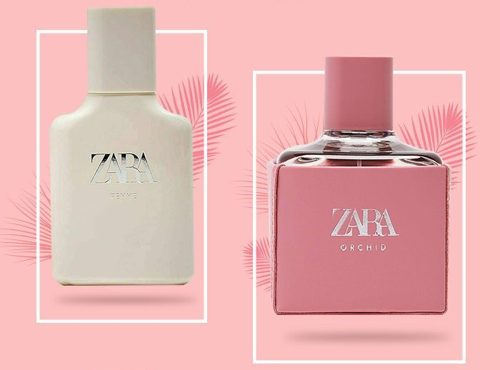
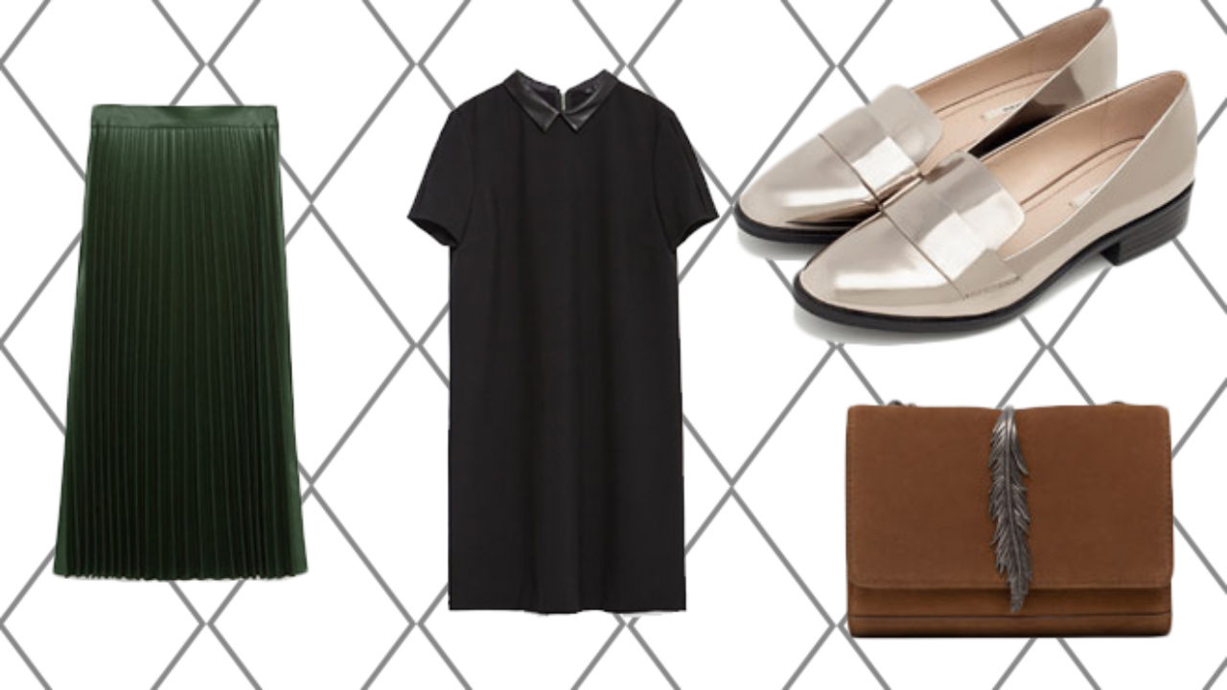
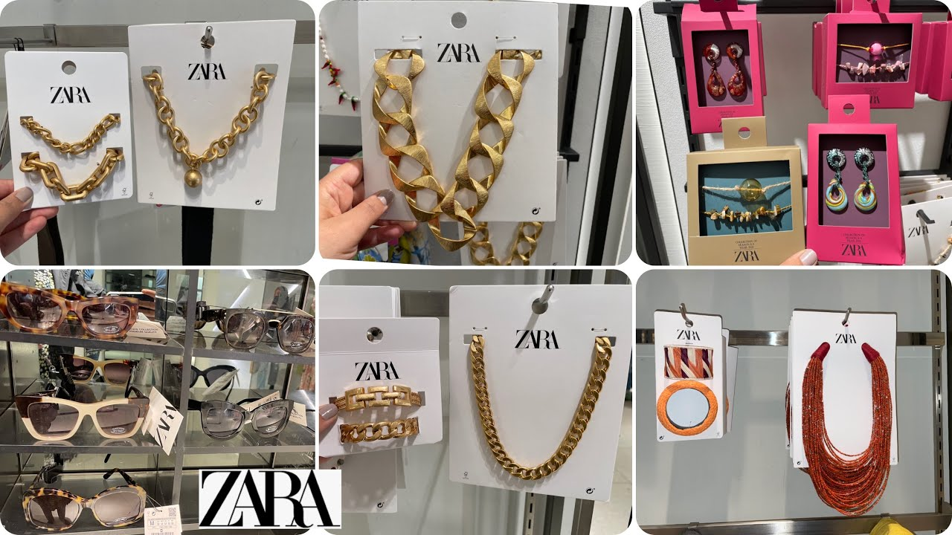
Offering a diverse range of fashion & beauty items: accessories, jewelry, footwear, clothing, perfume, etc.
PRO
DUCT

Slide 10
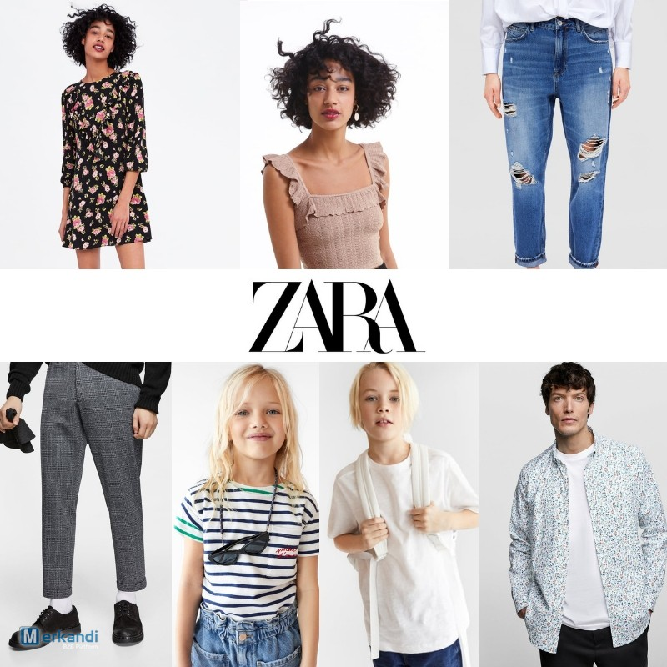

CLOTHING
PRODUCT
LINES
Zara Women
Zara TRF (Trafaluc)
Zara Men
Zara Kid
Zara Beauty

Slide 11
DISTRIBUTION CHANNEL
1. Traditional Stores
More than 2,000 stores, including its kids and home stores.
96 countries and is the flagship brand of the Inditex Group.
CONCEPT | COMPANY MANAGED | FRANCHISED | TOTAL
Zara | 1,763 | 262 | 2,025
Zara Kids | 93 | - | 93
Zara Home | 454 | 81 | 535
Table. Company-managed & Franchised Stores At The End 2020
* Inditex Group Annual Report 2020

Slide 12
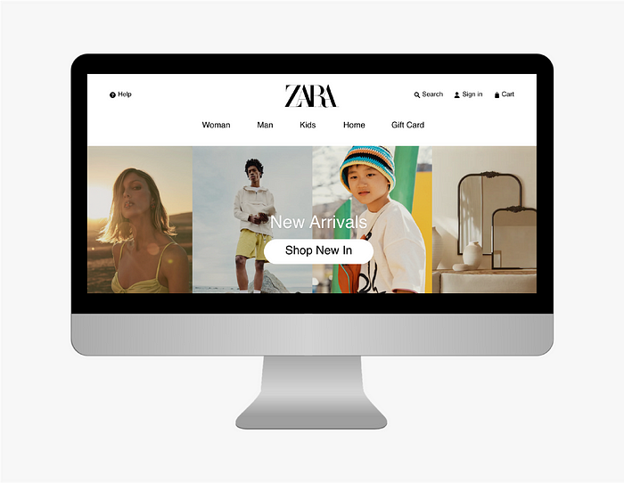
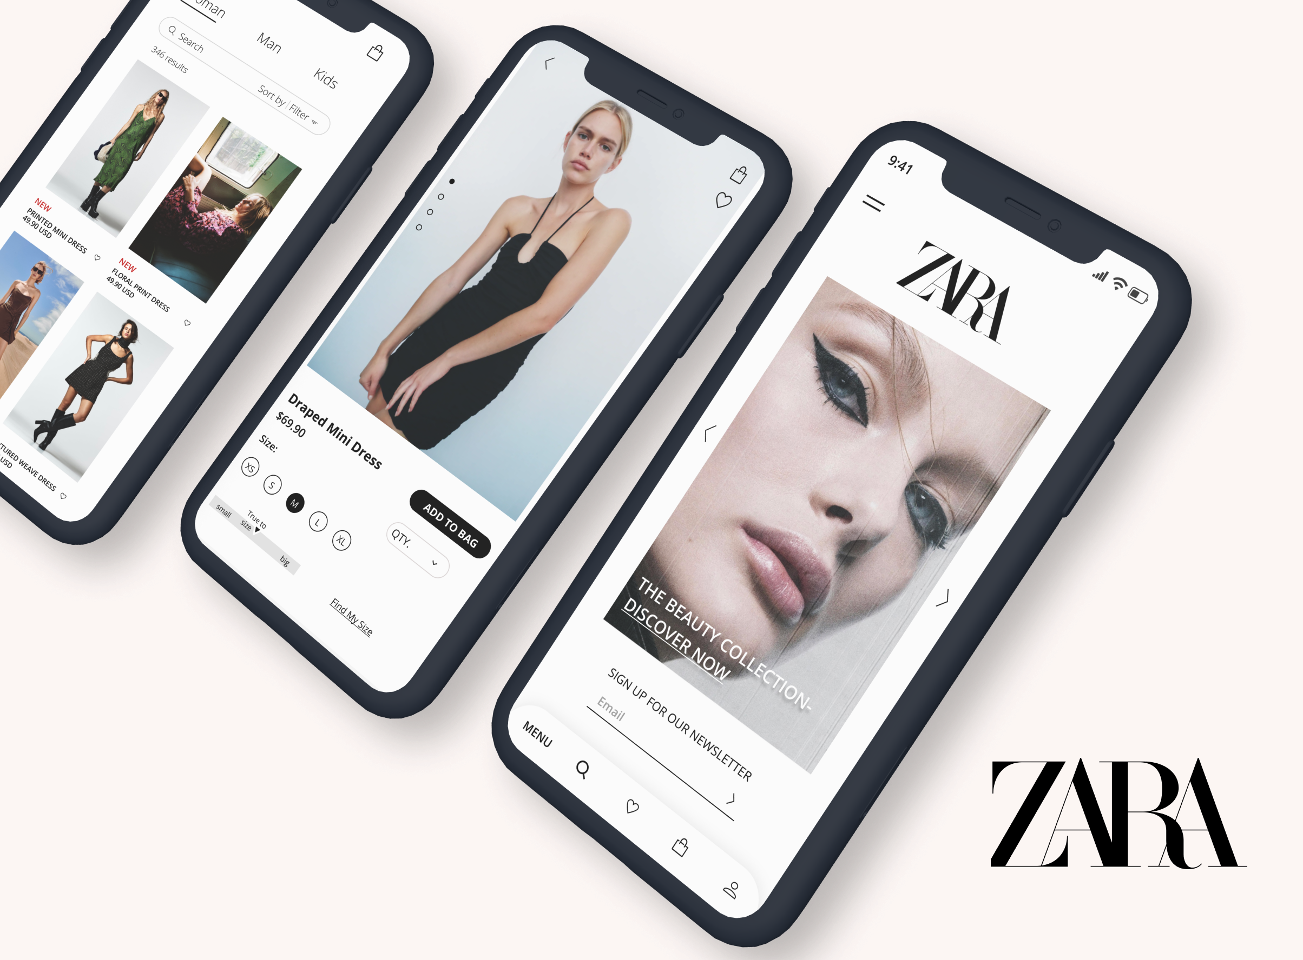
DISTRIBUTION CHANNEL
2. Online Stores
Website www.zara.com
Zara app on Google Play & App Store

Slide 13
Stakeholder groups
Employees | Customers | Suppliers | Community | Environment | Shareholders
Contribution to sustainable development
BUSINESS
MODEL
Respect for human rights
Design
Creativity
Transparency
Sustainability
Flexibility
Store
Online
CUSTOMER
Production
Logistics
* Inditex Group
Annual Report
2020
Pillars on which our strategy is established
Fashion | Customer experience | People | Sustainability

Slide 14

REVENUE MODEL
Pricing strategy
Based on the market
Revenue source
Traditional Stores
Online Stores

Slide 15




MARKET
ANALYSIS
COMPETITOR
ANALYSIS
SW
OT
CURRENT STATE ASSESSMENT
SWOT
ANALYSIS
SUGGESTED
SOLUTIONS

Slide 16
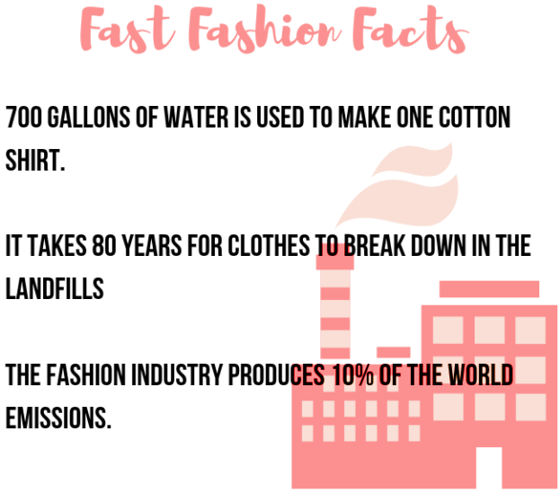
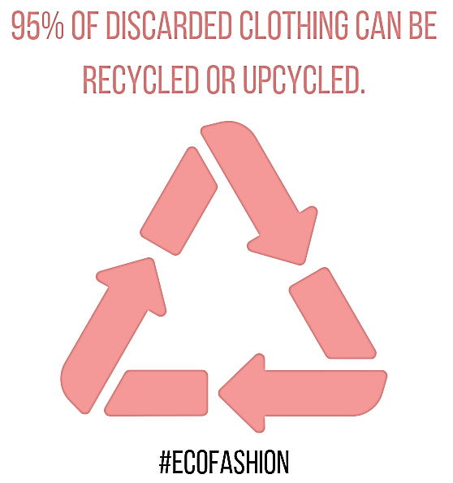
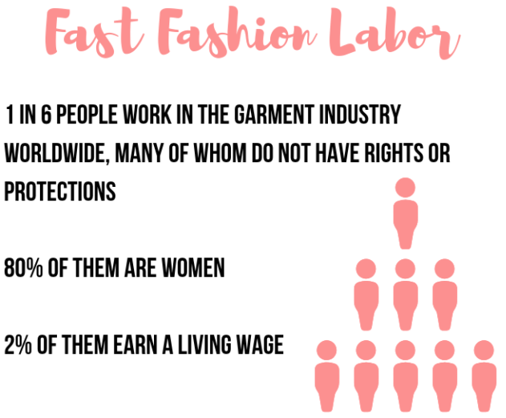
MARKET ANALYSIS
Mass-producing
Environment (-)
Cheap
Workers (-)
Quick
The characteristics of fast fashion

Slide 17
MARKET ANALYSIS
Revenue
Segmentation by gender: Female (60.3%).
Segmentation by age group: Adult (85.9%).
Geographical segmentation: Asia-Pacific (29.7%).
2019
35,80B USD
2020
25,09B USD
2021
30,58B USD
2025
39,84B USD
Year
The sales revenue of the
fast fashion market

Slide 18

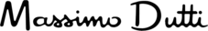











COMPETITOR ANALYSIS
Internal
External
Internal
Inditex
Others

Slide 19

COMPETITOR ANALYSIS
Establishment | 1947, Sweden | 1949, Japan | 1975, Spain
Size (2020) | 5,018+ stores in 74 countries | 2,250+ stores in 25 countries | 2,025+ stories in 96 countries
Sales revenue (2020) | ~ 20,2B USD | ~ 17,2B USD | ~ 21,9B USD
No. of available products | 17,715+ products | 1,960+ products | 6,313+ products
Clothing sizes | XXS -> 3XL | XXS -> XXL | XS -> XL

Slide 20
COMPETITOR ANALYSIS
Advertisement | 5% of revenue. Diverse channels. Collab with singers, models, and athletes. | 4.6% of revenue. Fewer diverse channels. Utilizes the names of celebrities. | Non-advertising campaign. 0.3% of revenue.
Discounts, promotions | Seasonal. | Seasonal, discounts for students. | Between June and the end of December.
Clothing design | Keeping up with the latest fashion trends. | Simple yet high-quality, meticulous. | Keeping up with the latest fashion trends.

Slide 21
COMPETITOR ANALYSIS
Pricing strategy Retviews. Women fashion. 2019
€ | H&M | Uniqlo | Zara
0 – 10€ | 12.5 | 8.0 | 7.5
10 – 20€ | 35.7 | 27.2 | 28.2
20 – 30€ | 26.2 | 35.0 | 24.9
30 – 40€ | 12.9 | 14.1 | 18.4
40 – 50€ | 4.9 | 3.9 | 11.5
50€+ | 4.0 | 3.3 | 5.7

Slide 22
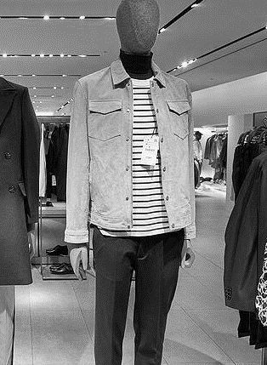
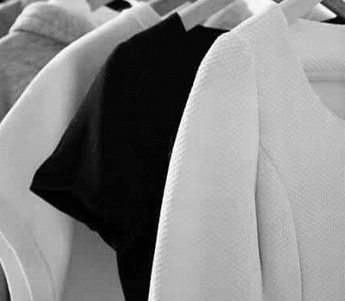
SWOT ANALYSIS
Large number of retail stores.
Expanding retail network.
Large team of designers.
Sustainability in fast fashion.
Over-reliance on traditional stores.
Diminished presence in the U.S. & Asia.

Slide 23
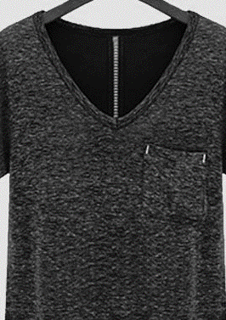

SWOT ANALYSIS
Utilizes technology.
Online shopping.
Invests in marketing.
Environmentally friendly.
Market expansion.
Internal & external competition.
Cost of raw materials.
Impact from the COVID-19 pandemic.
Legal and political considerations.
Environmental sustainability.

Slide 24
SUGGESTED SOLUTIONS
Competitive strategies
Cost reduction
Developing e-commerce to cope with the COVID-19 pandemic
Data analysis
Online communication
RFID technology
Collaboration with technology companies
Legal and political
Green fashion

Slide 25
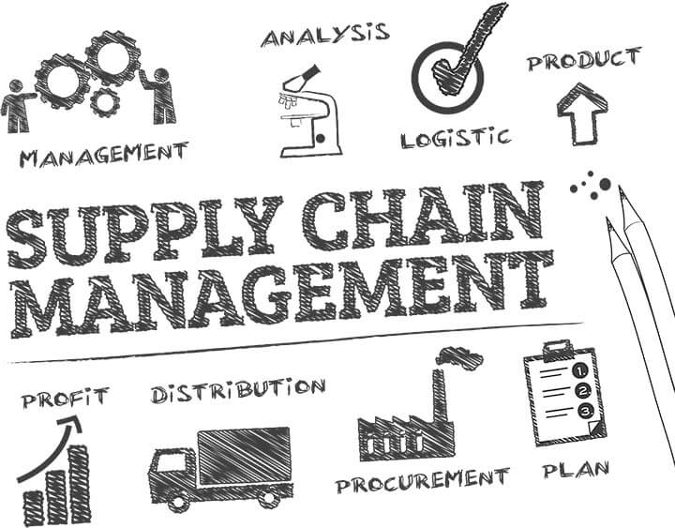
SUPPLY CHAIN ANALYSIS
Model
Core Activities
Measuring Performance

Slide 26
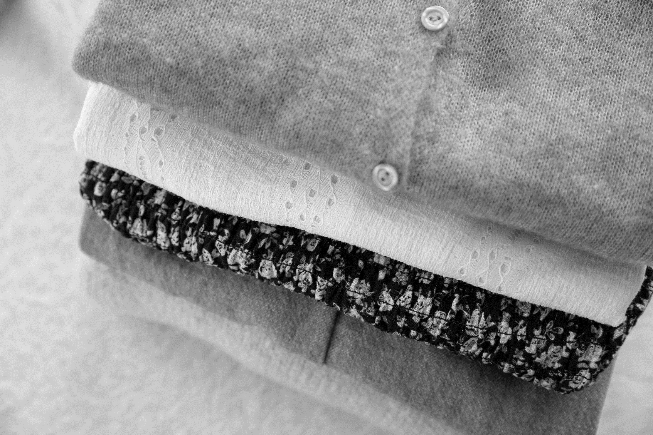
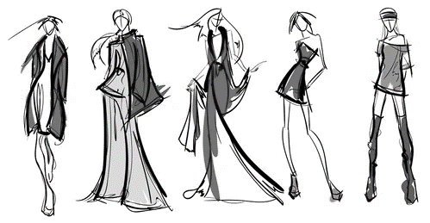
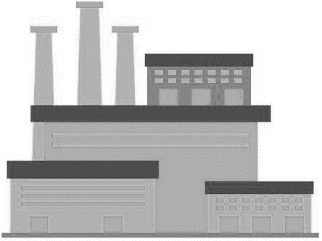
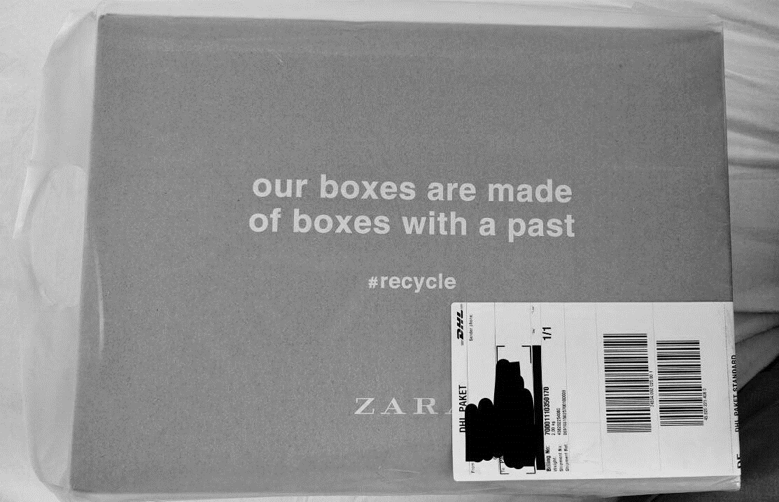
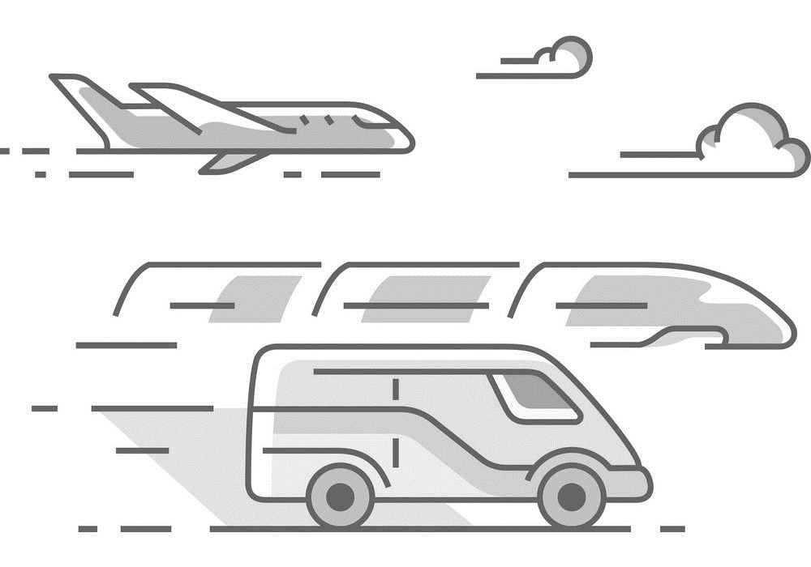
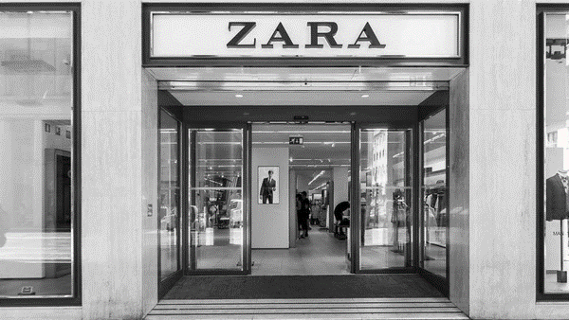
SC MODEL
2 – 3 weeks
RAW MATERIALS
DESIGN
MANUFACTURE
PACKAGE & LABEL
DELIVER
ZARA STORES
Warehouse distribution
Sales report
Market research
The elements in Zara's supply chain

Slide 27
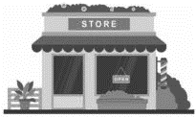

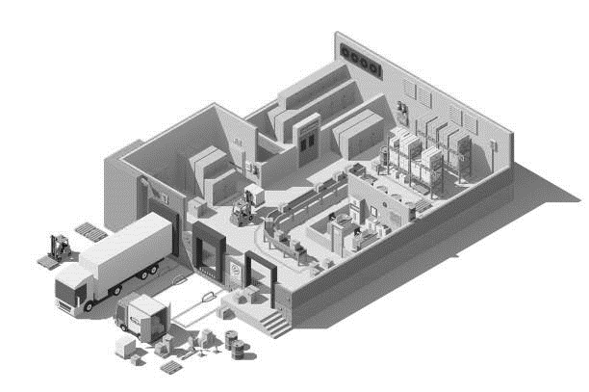


SC MODEL
Zara’s supply chain model
VERTICAL INTEGRATION
ZARA STORES
SUPPLIERS
DISTRIBUTION CENTER –
THE CUBE
LOGISTICS DISTRIBUTION CENTER
CUSTOMERS
FACTORIES

Slide 28

CORE ACTIVITIES
1. PLANNING
Demand Forecasting
Short-term demand forecasts, highly accurate (2 – 6 weeks).
Monitor customer feedback.
Produce small batches.
Product Pricing
Low-cost workers, raw materials, design costs, advertising & fast production progress

Slide 29
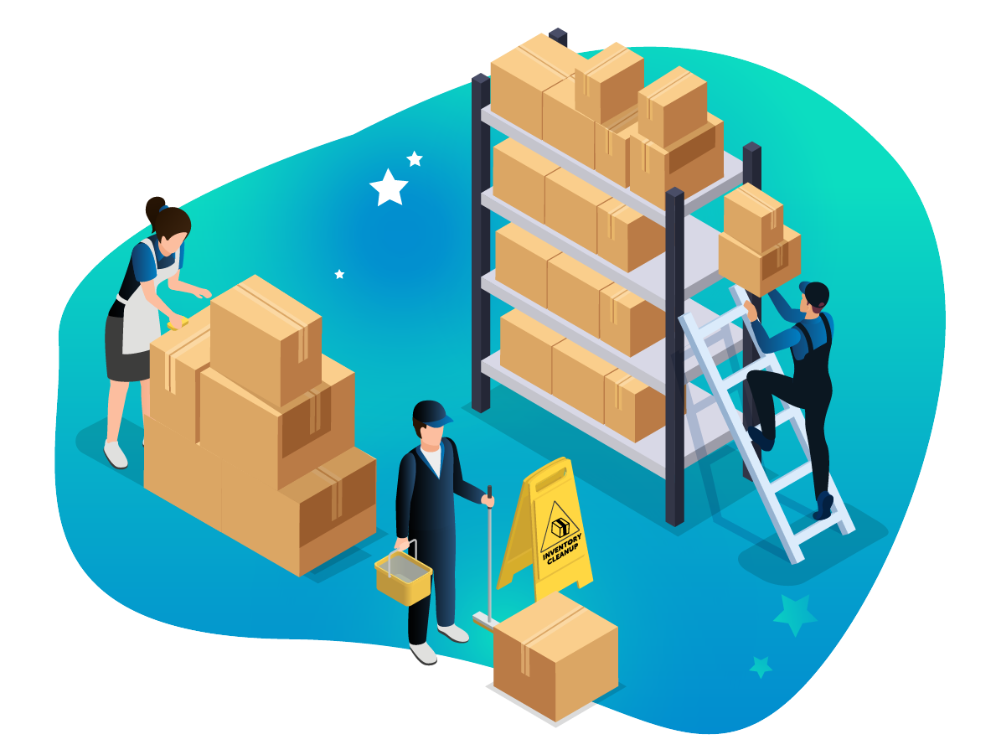
CORE ACTIVITIES
1. PLANNING
Inventory Management
Maintained at a low level.
Small quantity of products/design samples.
Internal production & reserve capacity allow flexibility in terms of quantity, frequency & diversity of products, responding quickly to the increasing demand.

Slide 30

2. SOURCING
Purchasing
Having products in the right location & quantity.
Evaluating the supply market.
Consumption Management
Use 1 of the procurement departments of Inditex.
Work with suppliers across 50 markets.
Vendor Selection
(3T): Time, Trust, Transparency.
CORE ACTIVITIES

Slide 31
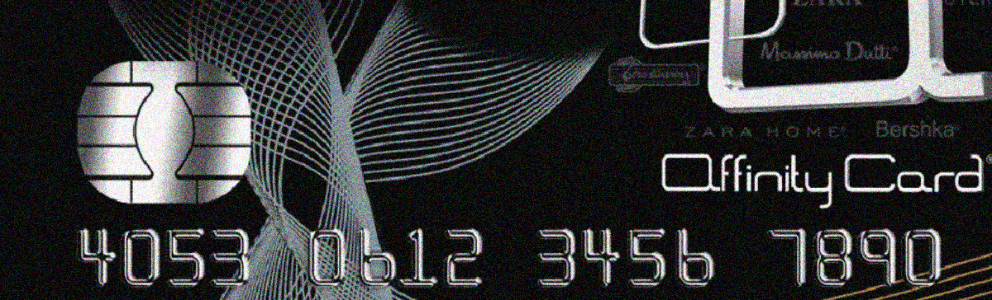
CORE
ACTIVITIES
2. SOURCING
Credit and Collections
Currently collaborated with Vietcombank, etc., for payments and refunds when using bank cards at Zara stores.

Slide 32
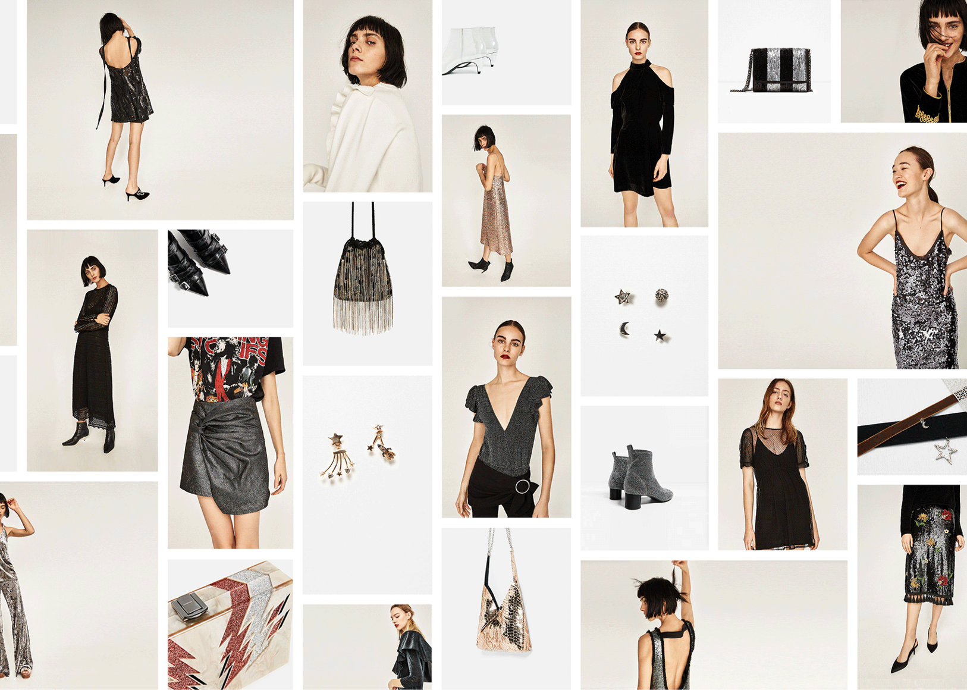
3. MAKING
Product Design
Focus on customers.
Monitor preferences & feedback from customers.
After completing the product, the factory sends reports and products to the distribution center.
CORE ACTIVITIES

Slide 33
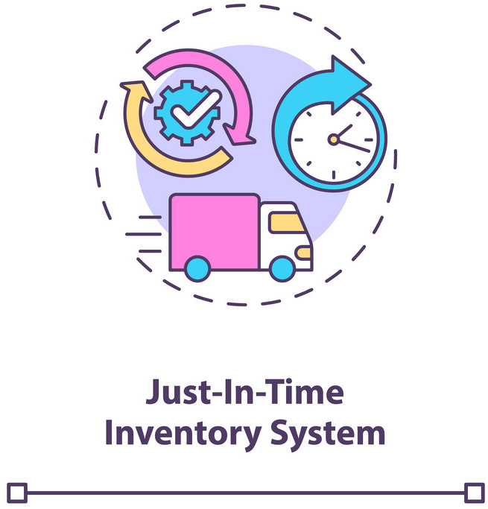
CÁC HOẠT ĐỘNG
CỐT LÕI TRIỂN KHAI
3. MAKING
Production Scheduling
Just In Time (JIT) production process.
Concentration of distribution &
production centers.
Facility Management
Competing based on flexibility and agility.
50% of the products are manufactured in Spain; 26% produced in the rest of Europe, 24% in Asia & Africa.

Slide 34
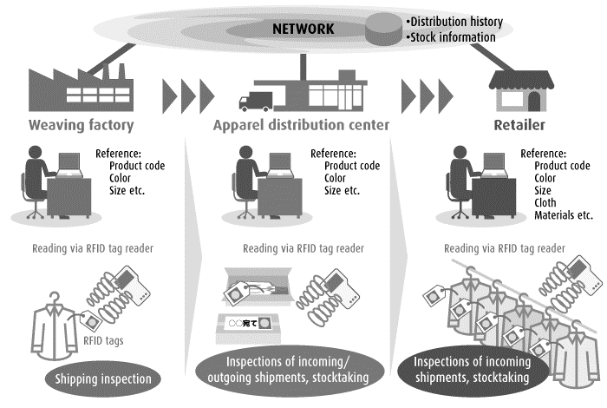
CORE ACTIVITIES
4. DELIVERING
Order Management
Orders are tracked through the IT system.
Delivery Scheduling
Distribution Center: The Cube.
Return Processing
Customers have 30 days to return/exchange products.
Take 14 days for a refund.

Slide 35
SC MEASURING PERFORMANCE
1. INTERNAL EFFICIENCY
INVENTORY VALUE Low inventory levels, relatively stable. Unsold inventory rate is about 10%. | INVENTORY TURNS Inventory Turnover Ratio = 12 per year
CASH-TO-CASH CYCLE TIME ROS is high and stable from 2016 to 2019. Decrease in 2020 due to the impact of the COVID pandemic.
 | 2016 | 2017 | 2018 | 2019 | 2020
ROS | 17.96 | 17.88 | 17.65 | 17.23 | 6.87

Slide 36

SC MEASURING PERFORMANCE
2. CUSTOMER SERVICE
Order fulfillment cycle time
Orders from retail stores:
Placed twice a week.
Received within 2 days.
Customer orders:
Processed in 1-2 days.
Usually delivered in 3-5 days.

Slide 37

SC MEASURING PERFORMANCE
3. DEMAND FLEXIBILITY
ACTIVITY CYCLE TIME Average time for a new product from design to shelf placement is 4-6 weeks. Short production time, taking ~ 10-15 days from the manufacturing stage to product shipment to stores. | UPSIDE FLEXIBILITY Short-Term demand production: 2-6 weeks. Manufacturing plants operate at a max capacity of 4.5 days/week. Maintain in-house product & ensure that factories reserve 85% of their capacity.
CONCLUSION
Zara's supply chain is highly responsive and super-efficient.

Slide 38

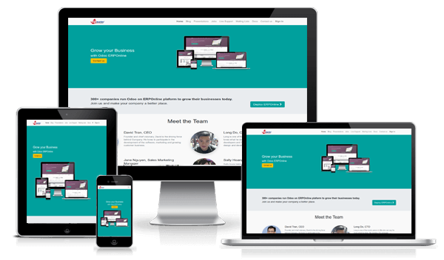
INTEGRATING ERP INTO
SUPPLY CHAIN MANAGEMENT

Slide 39
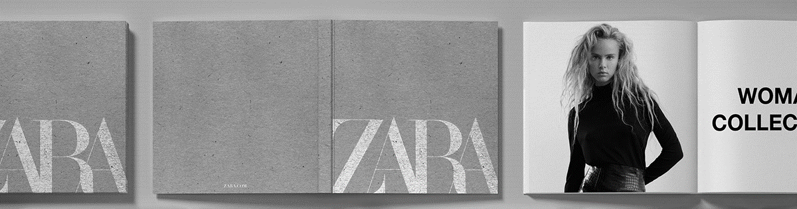
CONCLUSION

Slide 40

THANK YOU
FOR LISTENING

